Slide 1





Recover and Identify: A Generative Dual Model for Cross-Resolution Person Re-Identification
Yu-Jhe Li^{1,3*}
Yun-Chun Chen^{1,2,3*}
Yen-Yu Lin²
Xiaofei Du⁴
Yu-Chiang Frank Wang^{1,3}
¹NTU
²Academia Sinica
³NTU AI Center
⁴Umbo Computer Vision

Slide 2
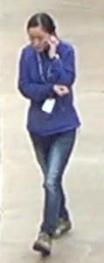
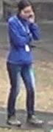
Person Re-Identification (re-ID)
Identify images of the same person captured by different cameras
Same person

Slide 3
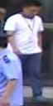
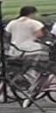

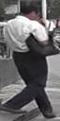
Challenges in Person Re-ID
Occlusion
Background Clutters
Pose Variations

Slide 4
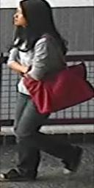




Resolution Variations
Varying distances between the camera and the person of interest
Resize
Short distance → High resolution
Long distance → Low resolution

Slide 5
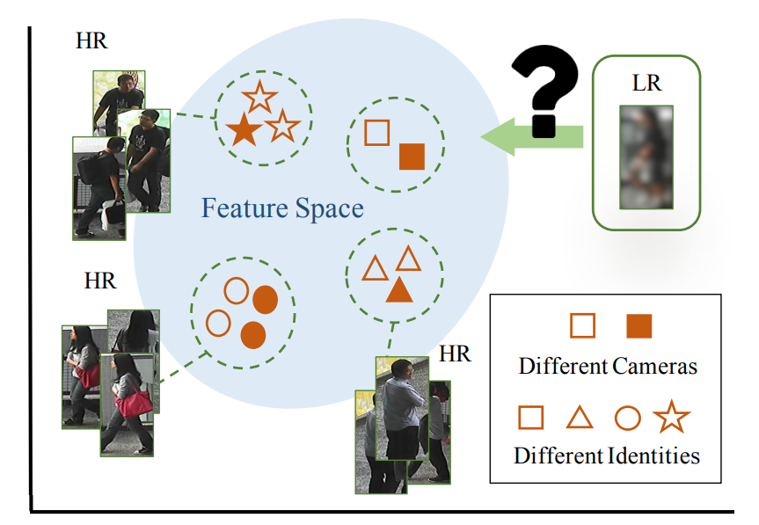
Cross-Resolution Person Re-ID
Resolution mismatch issue due to cross-resolution images.

Slide 6
Existing Strategies

Slide 7
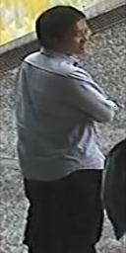

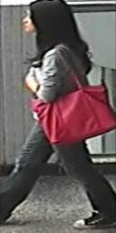
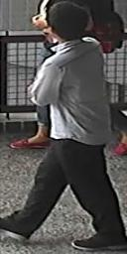
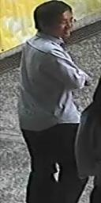
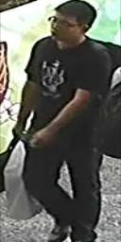
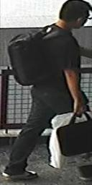
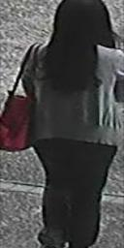
Existing Strategies: SR for Cross Resolution Re-ID
1. Image Recovery
2. Person Re-ID
Query
SR 2x
SR 3x
Gallery
SR 4x
Jiao et al. Deep Low-Resolution Person Re-Identification. In AAAI, 2018.
Wang et al. Cascaded SRGAN for Scale-Adaptive Low Resolution Person Re-Identification. In IJCAI, 2018.
7

Slide 8
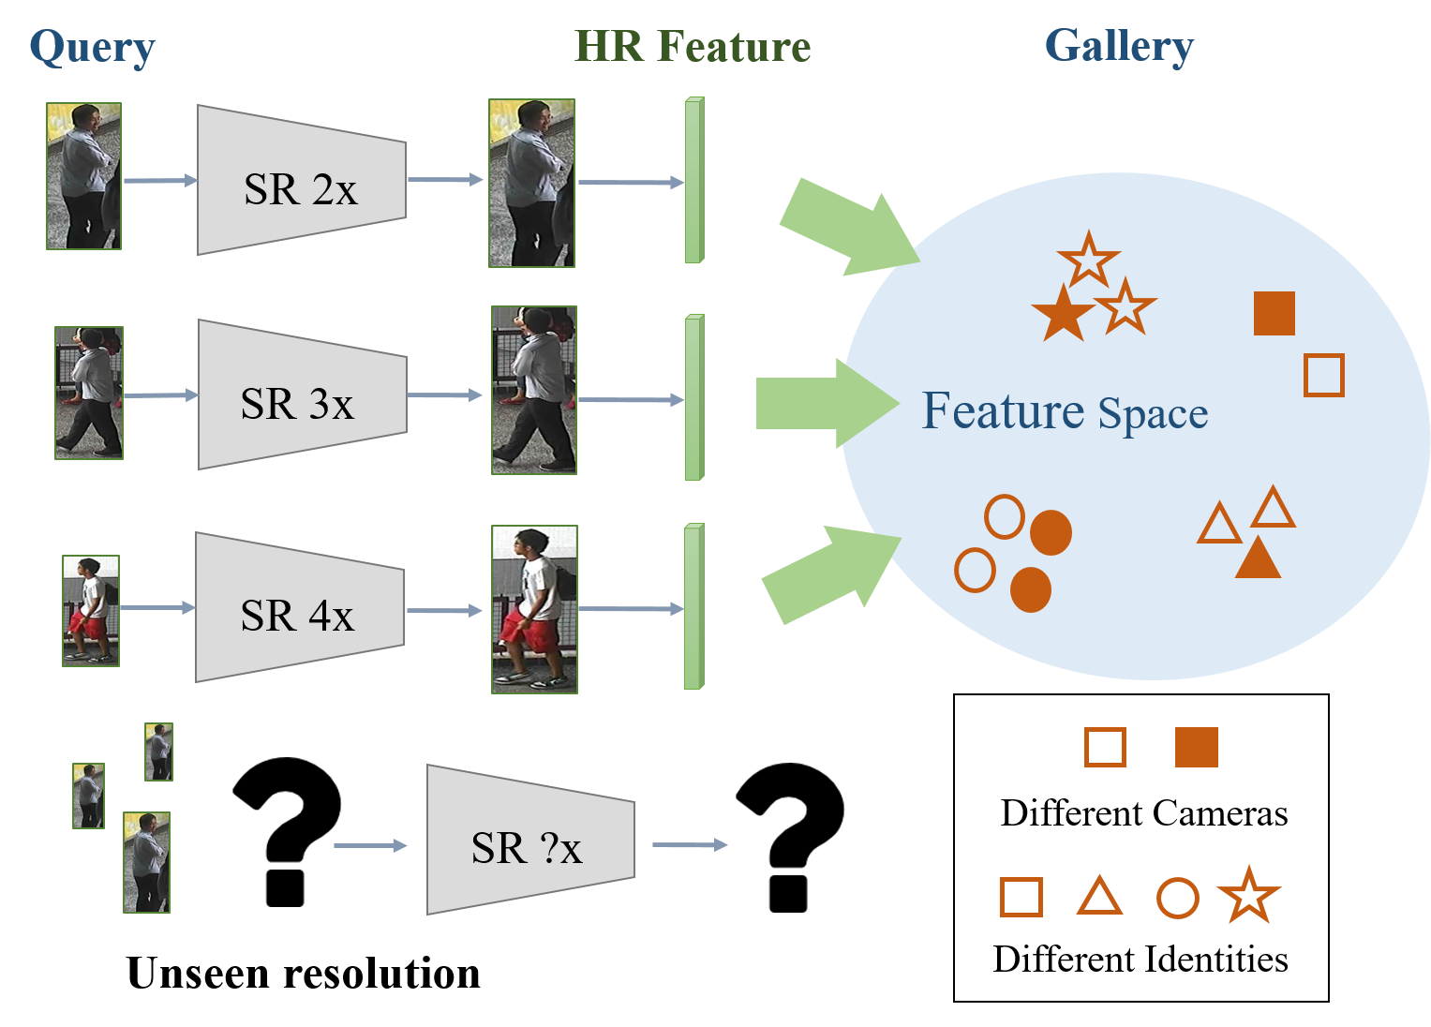
Limitations of Existing Strategies
Unseen resolutions

Slide 9
Our Motivation

Slide 10
Resolution-Invariant Representations
Query
Resolution-Invariant Representations
Gallery
Encoder
Notes:
給不同resolution query 希望取到相近 甚至幾乎一樣的feature

Slide 11
Proposed Method

Slide 12
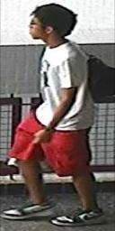

LR:${ x}_{L}$
HR/LR Image Space
Encoder $(ℰ)$
$$f$$
HR:${ x}_{H}$
$$f_{H}$$
$$𝒟_{F}$$
$$ℒ_{adv}^{D_{F}}$$
$$f_{L}$$
Resolution Adversarial Learning

Slide 13
LR:${ x}_{L}$
$${\tilde{x}}_{H}$$
HR Adversarial Learning
$$𝒟_{I}$$
$$ℒ_{adv}^{D_{I}}$$
HR/LR Image Space
Encoder $(ℰ)$
Decoder ($𝒢)$
HR Image Space
$$f$$
HR:${ x}_{H}$
${\tilde{x}}_{H}$
$$ℒ_{rec}$$
$$f_{H}$$
$$𝒟_{F}$$
$$ℒ_{adv}^{D_{F}}$$
$$f_{L}$$
Resolution Adversarial Learning

Slide 14
LR:${ x}_{L}$
$${\tilde{x}}_{H}$$
HR/LR Image Space
Encoder $(ℰ)$
Decoder ($𝒢)$
HR Image Space
$$f$$
HR:${ x}_{H}$
${\tilde{x}}_{H}$
HR Encoder ($ℱ$)
$$g$$
$$v$$
Classifier ($𝒞)$
$$ℒ_{cls}$$

Slide 15
LR:${ x}_{L}$
$${\tilde{x}}_{H}$$
HR Adversarial Learning
Cross-Resolution GAN (CRGAN)
$$𝒟_{I}$$
$$ℒ_{adv}^{D_{I}}$$
HR/LR Image Space
Encoder $(ℰ)$
Decoder ($𝒢)$
HR Image Space
$$f$$
HR:${ x}_{H}$
${\tilde{x}}_{H}$
HR Encoder ($ℱ$)
$$g$$
$$ℒ_{rec}$$
Cross-Modal Re-ID
$$v$$
$$f_{H}$$
$$𝒟_{F}$$
$$ℒ_{adv}^{D_{F}}$$
$$f_{L}$$
Classifier ($𝒞)$
$$ℒ_{cls}$$
Resolution Adversarial Learning

Slide 16
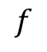
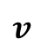
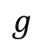
Cross-Modal Re-ID
$$f$$
$$g$$
$$v$$
Classifier ($𝒞)$
$$ℒ_{cls}$$

Slide 17
Evaluation

Slide 18
Datasets and Evaluation Metric
Datasets
CUHK03 [Li et al. In CVPR, 2014]
VIPeR [Gray et al. In ECCV, 2008]
CAVIAR [Cheng et al. In BMVC, 2011]
Market-1501 [Zheng et al. In ICCV, 2015]
DukeMTMC-reID [Zheng et al. In ICCV, 2017]
Evaluation Metric
Rank
Li et al. Deep-ReID: Deep Filter Pairing Neural Network for Person Re-Identification. In CVPR, 2014.
Gray et al. Viewpoint Invariant Pedestrian Recognition with an Ensemble of Localized Features. In ECCV, 2008.
Cheng et al. Custom Pictorial Structures for Re-Identification. In BMVC, 2011.
Zheng et al. Scalable Person Re-Identification: A Benchmark. In ICCV, 2015.
Zheng et al. Unlabeled Samples Generated by GAN Improve the Person Re-Identification Baseline in Vitro. In ICCV, 2017.

Slide 19
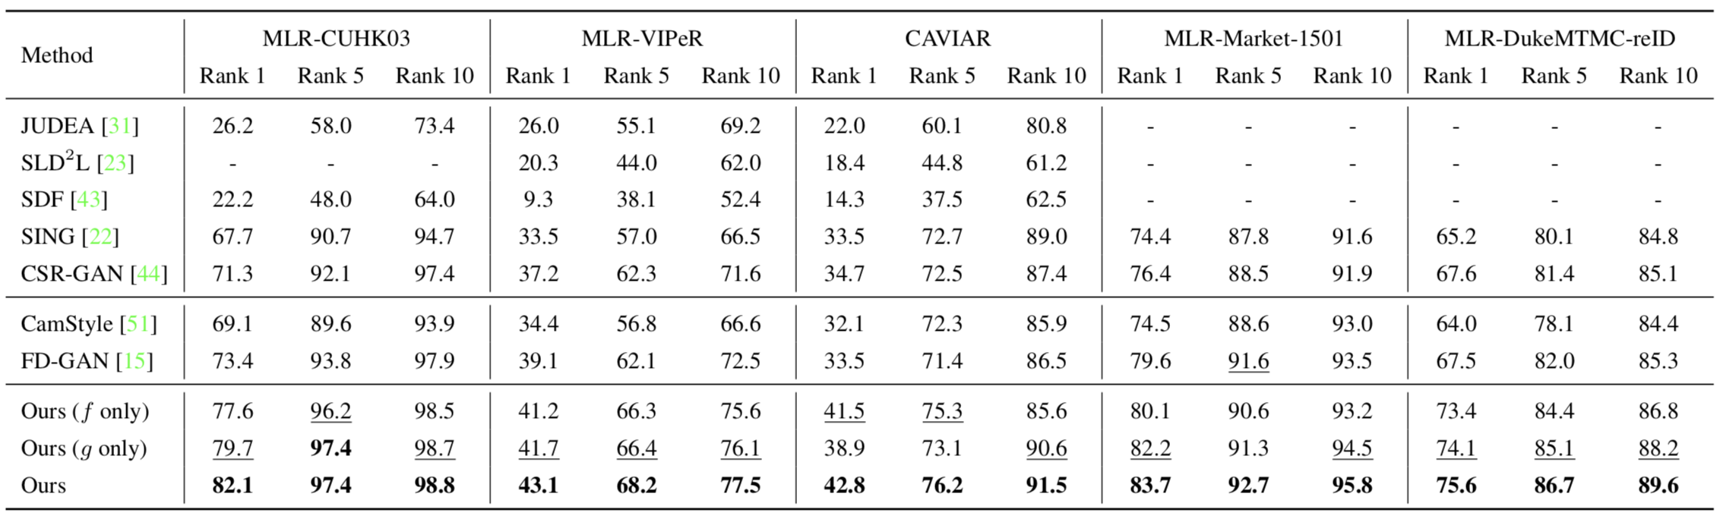
Evaluation on Cross-Resolution Re-ID
Li et al. Multi-Scale Learning for Low-Resolution Person Re-Identification. In ICCV, 2015.
Jing et al. Super-Resolution Person Re-Identification with Semi-Coupled Low-Rank Discriminant Dictionary Learning. In CVPR, 2015.
Wang et al. Scale-Adaptive Low-Resolution Person Re-Identification via Learning a Discriminating Surface. In IJCAI, 2016.
Jiao et al. Deep Low-Resolution Person Re-Identification. In AAAI, 2018.
Wang et al. Cascaded SRGAN for Scale-Adaptive Low Resolution Person Re-Identification. In IJCAI, 2018.
Zhong et al. Camera Style Adaptation for Person Re-Identification. In CVPR, 2018.
Ge et al. FD-GAN: Pose-guided Feature Distilling GaN for Robust Person Re-Identification. In NeurIPS, 2018.

Slide 20
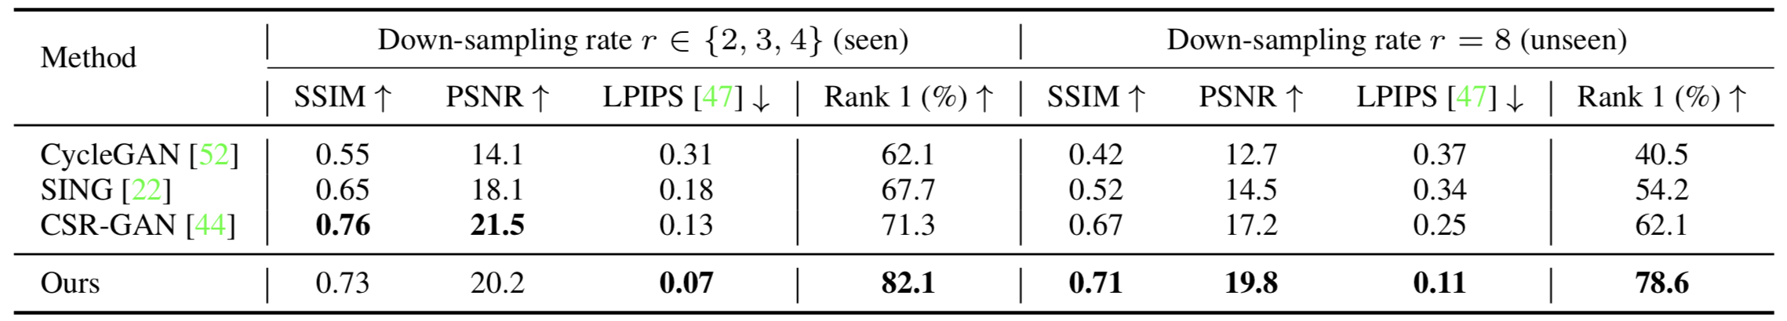
Evaluation on Image Recovery
Jiao et al. Deep Low-Resolution Person Re-Identification. In AAAI, 2018.
Wang et al. Cascaded SRGAN for Scale-Adaptive Low Resolution Person Re-Identification. In IJCAI, 2018.

Slide 21
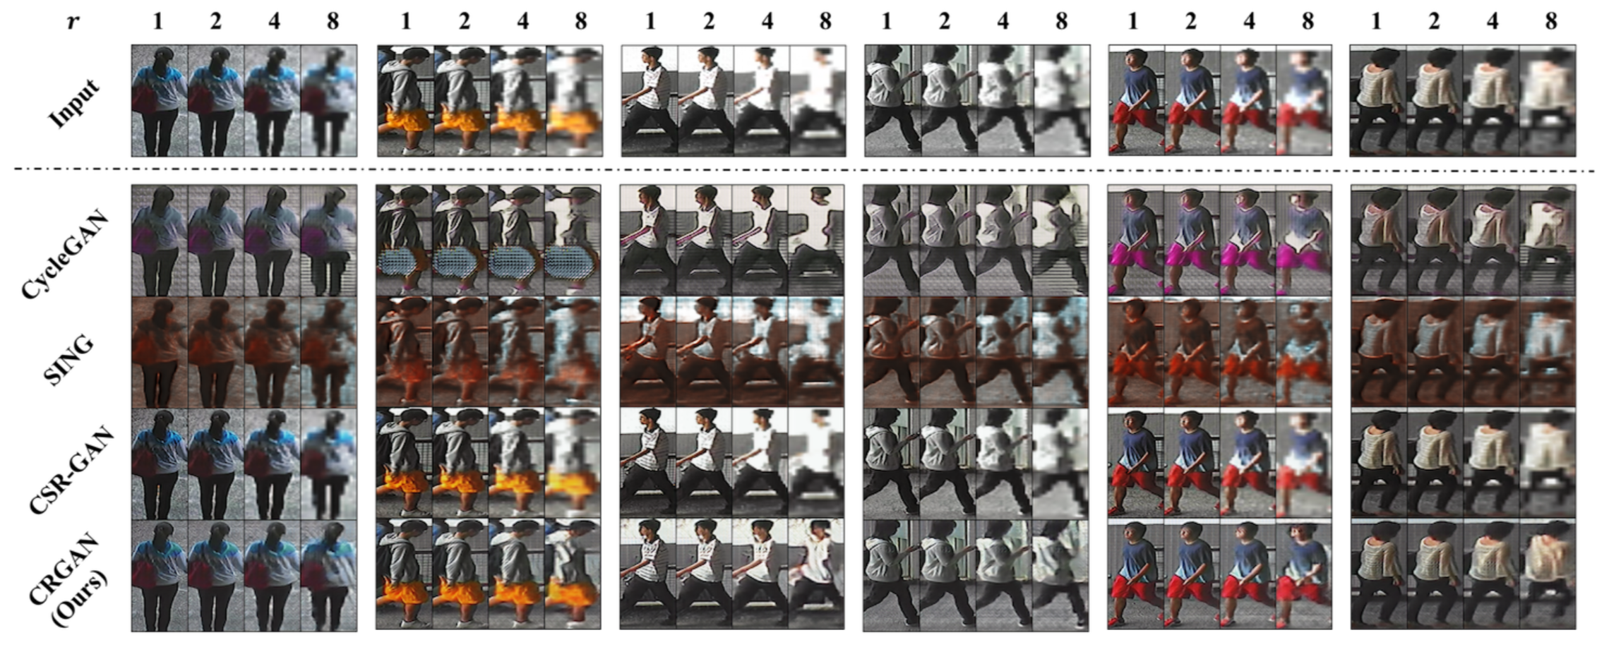
Recovered HR Images

Slide 22
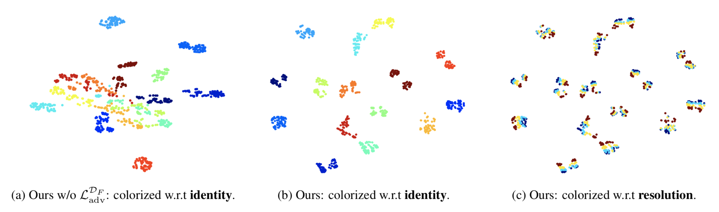
Resolution-Invariant Representations

Slide 23
Conclusions
Resolution-invariant representations
Re-ID oriented image recovery
Handle images of varying and even unseen low resolutions
State-of-the-art performances

Slide 24
Thanks for listening!

